Slide 1
Numerical Methods ICE 2142
Mursheda Nusrat Della
Lecturer
Dept. of ICE
BAUET
Lab 3

Slide 2
Read all the pages to understand this method and memorize only the equation 1 to solve math on this method.

Slide 3
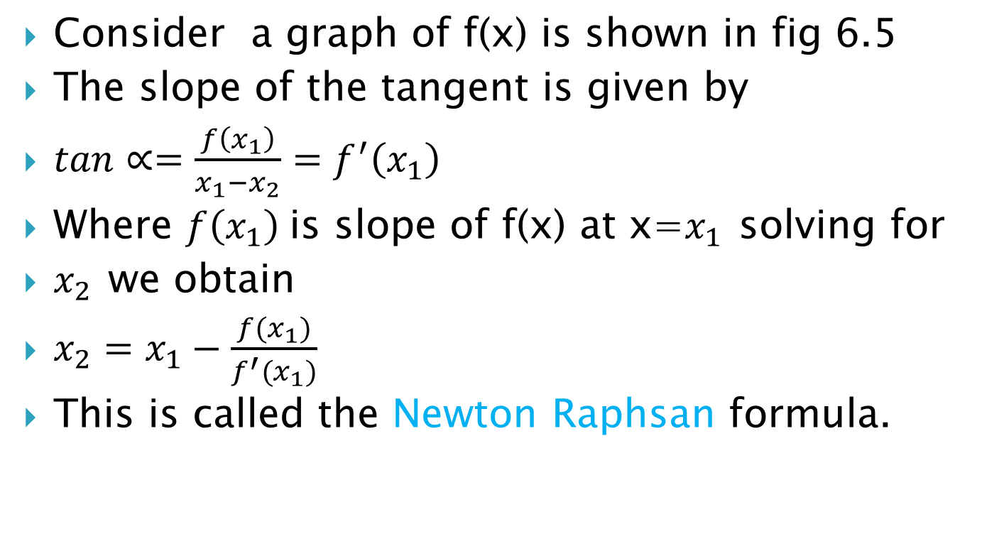
Consider a graph of f(x) is shown in fig 6.5
The slope of the tangent is given by
$tan∝=\frac{f\left(x_{1}\right)}{x_{1}−x_{2}}=f^{′}\left(x_{1}\right)$
Where $f\left(x_{1}\right)$is slope of f(x) at x=$x_{1 }$solving for
$x_{2 }$we obtain
$x_{2}=x_{1}−\frac{f(x_{1})}{f^{′}(x_{1})}$
This is called the Newton Raphsan formula.

Slide 4
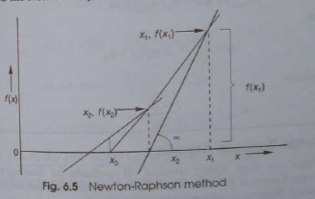
Newton raphsan method
The method of successive approximation is called the newton raphsan method.

Slide 5
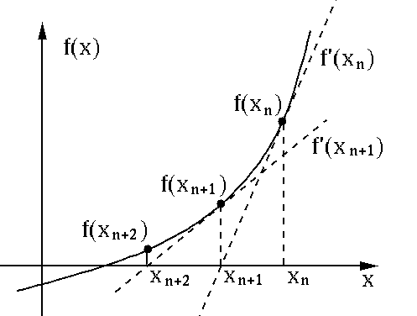
Newton raphsan method

Slide 6
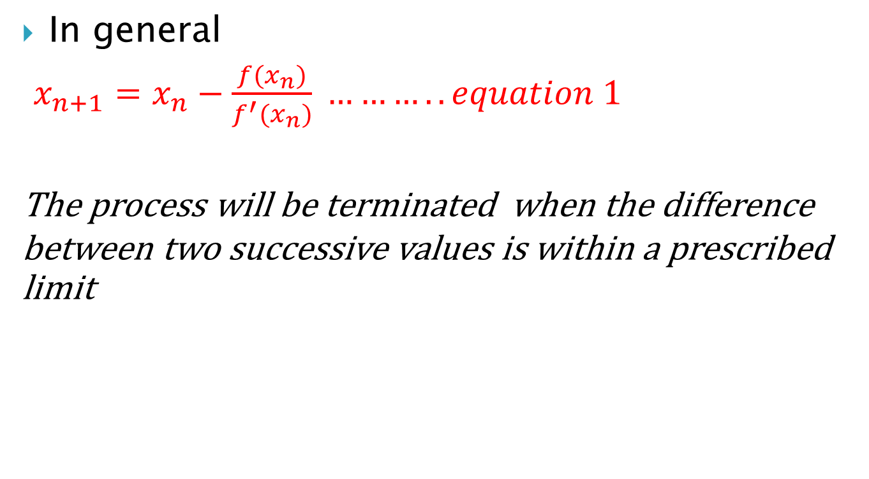
In general
$x_{n+1}=x_{n}−\frac{f(x_{n})}{f^{′}(x_{n})} ………..equation 1$
The process will be terminated when the difference between two successive values is within a prescribed limit

Slide 7
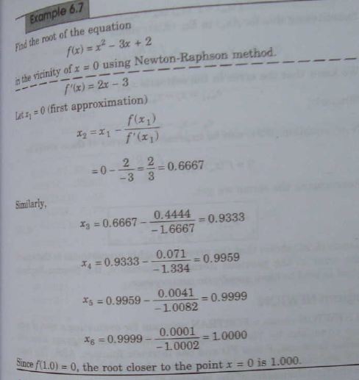

Slide 8
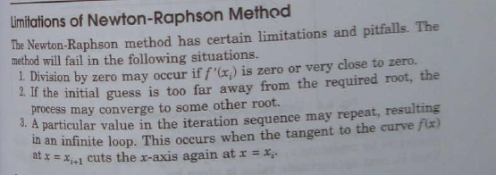

Slide 9
MATLAB code
f = @(x) x^2-3*x+2;
df = @(x) 2*x-3;
x0 = input('Enter the value of initial solution quess =');
if df(x0) ==0
fprintf('not a good initial solution\n');
return
end
for i=1:50
x1 = x0 - f(x0)/df(x0);
fprintf('%i %f\n',i,x1);
x0=x1;
if abs (f(x0)) < 1.0E-6
return
end
end

Slide 10
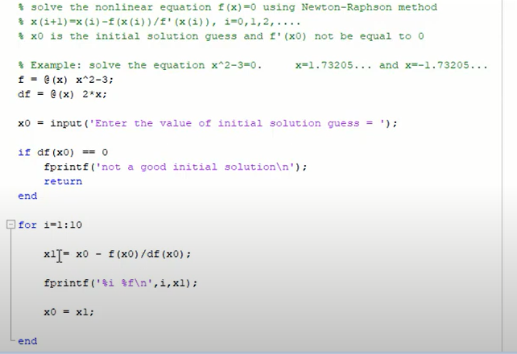

Slide 11
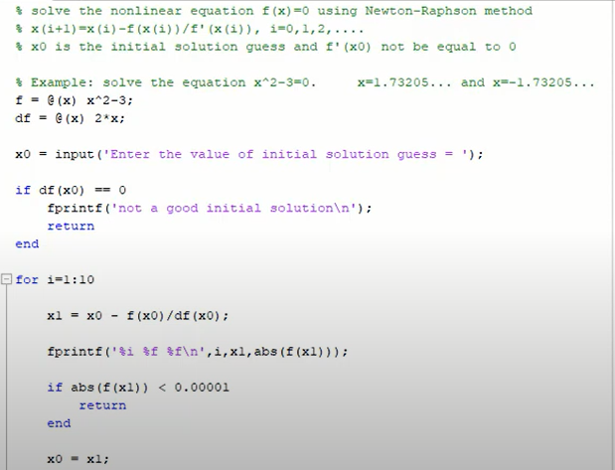

Slide 12
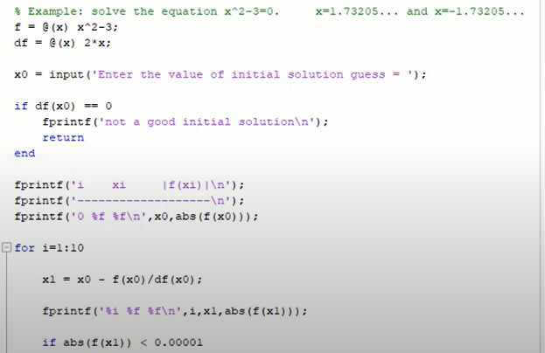

Slide 13
Find a root of an equation f(x)=x3-x-1 using Newton Raphson method
Solution: Here x3-x-1=0 Let f(x)=x3-x-1 ∴f′(x)=3x2-1
x | 0 | 1 | 2
F(x) | -1 | -1 | 5

Slide 14
Here f(1)=-1<0andf(2)=5>0 ∴ Root lies between 1 and 2 x0=(1+2)/2=1.5

Slide 15
1st iteration : f(x0)=f(1.5)=0.875 f′(x0)=f′(1.5)=5.75 x1=x0-(f(x0)/f′(x0)) x1=1.5-0.8755.75 x1=1.34783

Slide 16
2nd iteration :
f(x1)=f(1.34783)=0.10068
f′(x1)=f′(1.34783)=4.44991
x2=x1-(f(x1)/f′(x1))
x2=1.34783-0.100684.44991
x2=1.3252

Slide 17
3rd iteration : f(x2)=f(1.3252)=0.00206 f′(x2)=f′(1.3252)=4.26847 x3=x2-(f(x2)/f′(x2)) x3=1.3252-0.002064.26847 x3=1.32472

Slide 18
4th iteration : f(x3)=f(1.32472)=0 f′(x3)=f′(1.32472)=4.26463 x4=x3-(f(x3)/f′(x3)) x4=1.32472-04.26463 x4=1.32472 Approximate root of the equation x3-x-1=0 using Newton Raphson method is 1.32472

Slide 19
